Slide 1
Restaurant Management System
A project based on MySQL, HTML, CSS, & PHP
By Akshat Sharma
19BAI1080

Slide 2
Abstract
Restaurant management system is a project that will be helping a restaurant function easily. It has a very user friendly frontend both for the restaurant as well as the customer who comes to the restaurant. These days whenever we go to restaurant and order, we have to wait for up to 45 minutes till the food comes. Using this the customer can schedule his visit and order the food around half an hour before they come to the restaurant so that they don’t have to wait. The restaurant also can beforehand plan what to make and what will be the day’s strength.

Slide 3
Overview
The frontend(website) is created using HTML, CSS, and PHP
The first page will be the login/signup page for the customer. If he doesn’t have an account, it will be created using a sign up option. After signing in, the person will be redirected to the main website. Here, he will be able to schedule his visit for the next 5 days and order food before he arrives to the restaurant so that the waiting time is minimized. After he reaches, he always has the option to order more food and on the site click finish button when he has had his meal and he’ll pay according to the way he wants. The server used as localhost is XAMPP server

Slide 4
Overview contd.
If he uses the website, the user will get special discounts and can handle his payment and look at the bill from there only
The website is purely HTML 5 and CSS 3 while JavaScript is used as the scripting language which the browser will use. PHP is used to access the server and for interaction. The server is a localhost made by XAMPP. PHPMyAdmin is used for administration of the database
Whenever the person signs-up, the data he entered will be stored in the database created by MySQL. When the user signs in, PHP will use the ‘POST method to get the data from the database and the user will be directed to the main website on a successful login.

Slide 5
Features of My Website
Sessions are used so that the person can be logged in for as much time as he wants. To log out, logout buttons are there on every page.
On a successful signup, the user receives a welcome email on the account he has registered on.
The minimum length of password is set as 6 characters and every field is mandatory.
On giving a null value to any field, a prompt is generated.
The user can view the menu, and in any case he doesn’t like the menu or changes his mind due to any reason, he/she can log-out there itself.
If a user wants to add more items to his order, that option is also given
Method of payment is also given which is though dummy(for that to work, the website should be live on a domain and the plugin is paid). The user can choose various ways in which he wants to pay.
In the end the total order with the bill is shown.
The XAMPP server is the localhost server and PHPMyAdmin is the DB administrator.

Slide 6
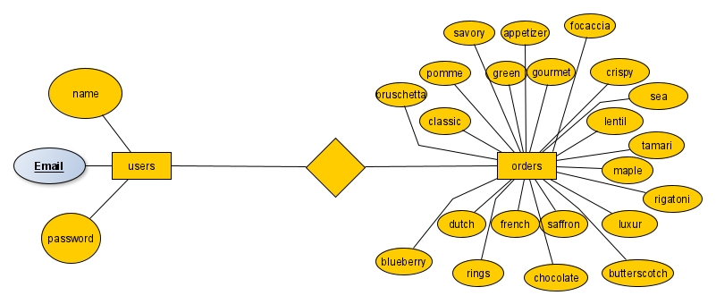
ER Diagram

Slide 7
Dataset Description
For the customer to sign up, he will have to give in his name, email and create a password. All this will be stored in a table named users in the database named signup.
On logging in, PHP will access the DB and see if the initials are correct. If so the user is redirected to the table reservation page. After reserving, he is shown the menu and he orders the food in the menu itself.
All the order is stored in a new table called orders.
The database will get accessed and hence the whole system will work.

Slide 8
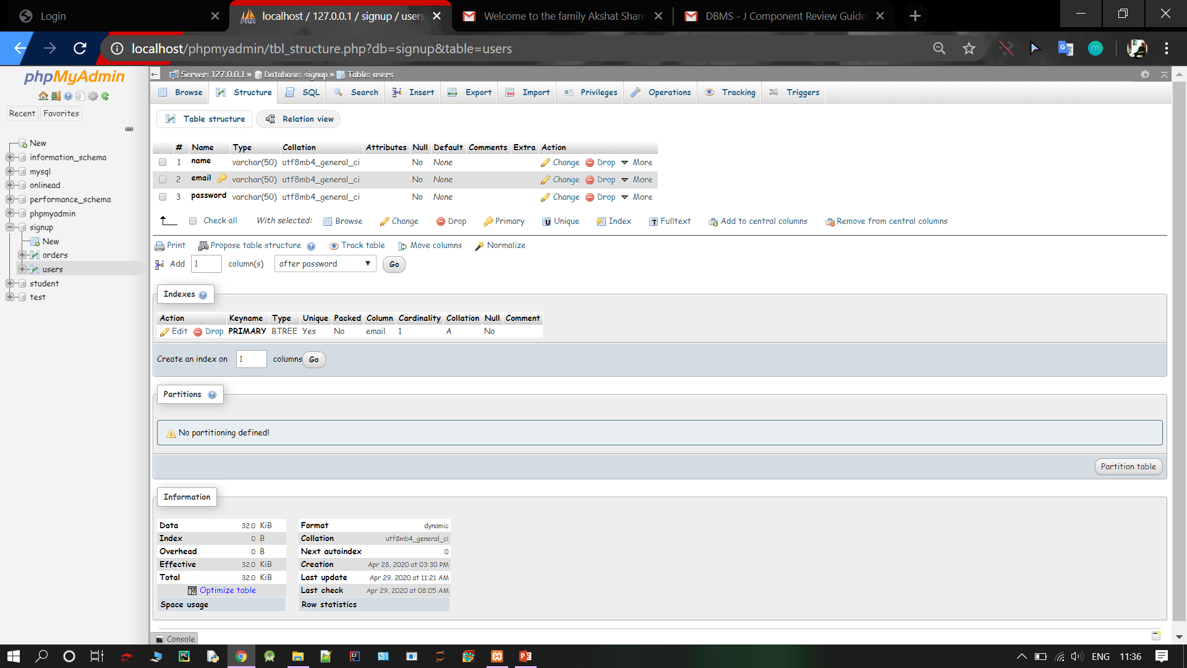
TABLE USERS IN SIGNUP DATABASE

Slide 9
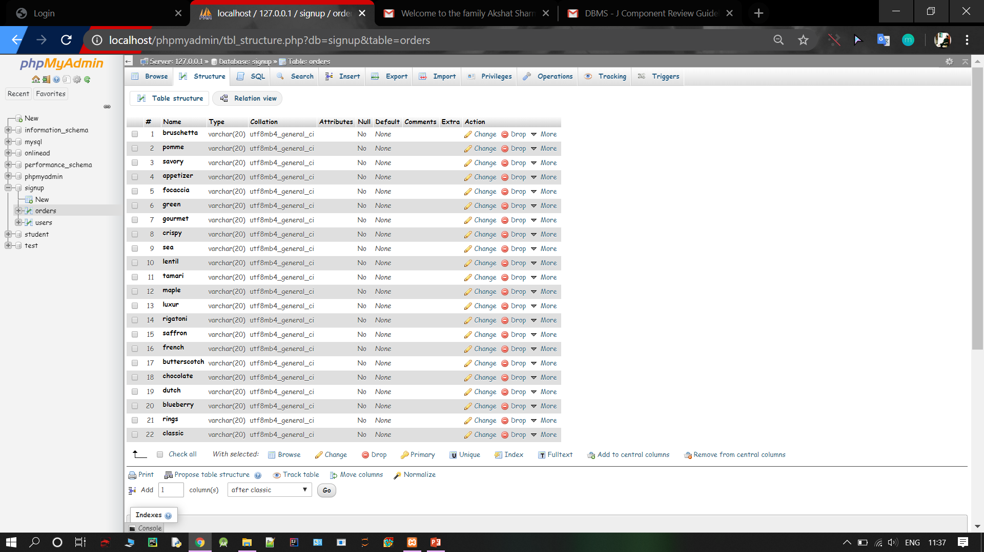
TABLE ORDERS IN SIGNUP DATABASE

Slide 10
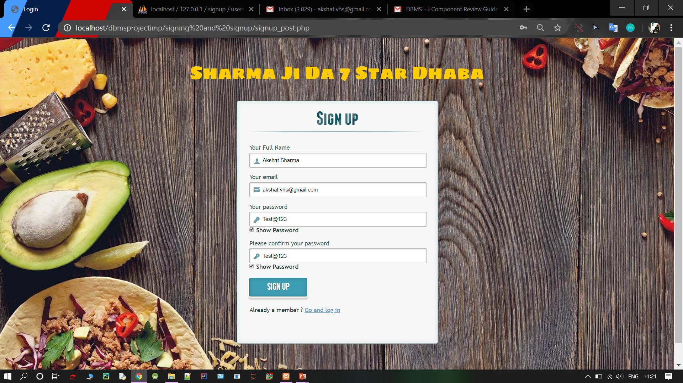
THE SIGNUP PAGE

Slide 11
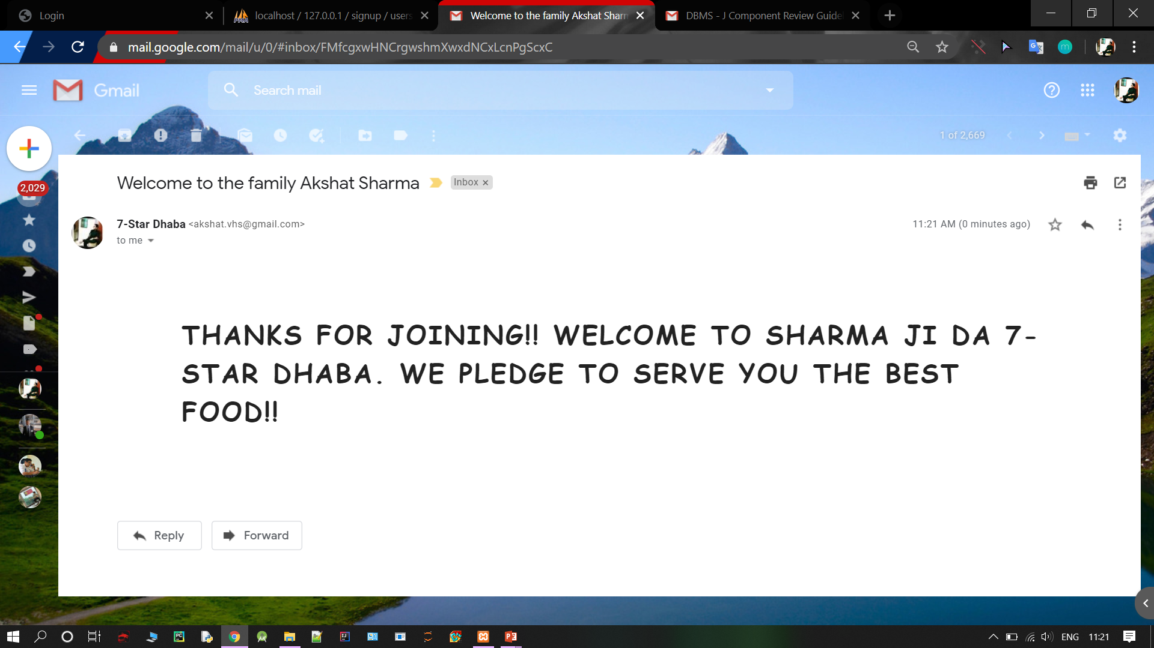
WELCOME EMAIL ON SUCCESSFUL SIGNUP

Slide 12
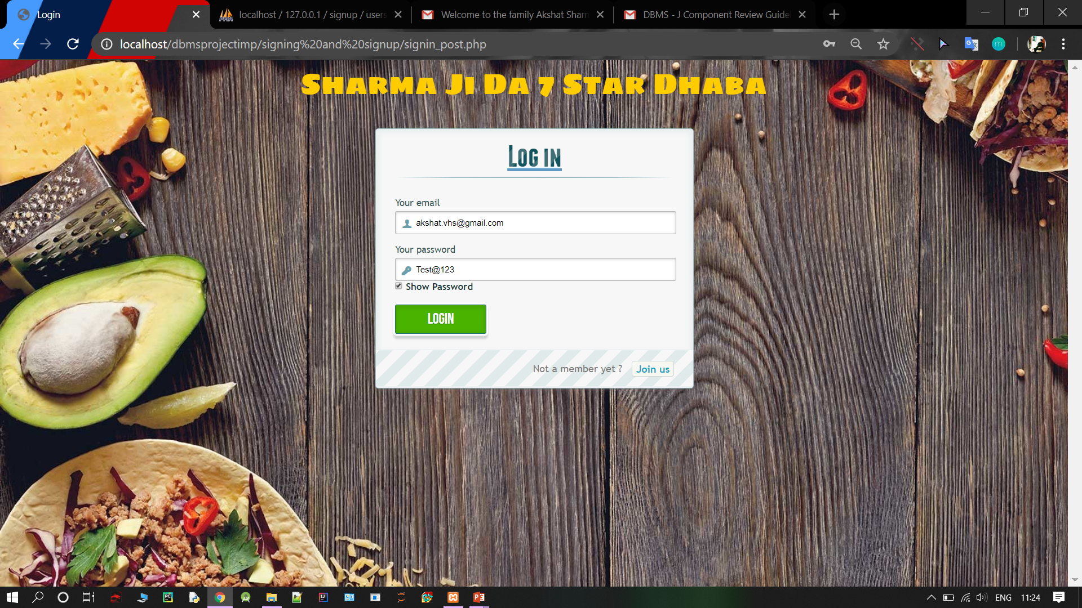
THE LOGIN PAGE

Slide 13
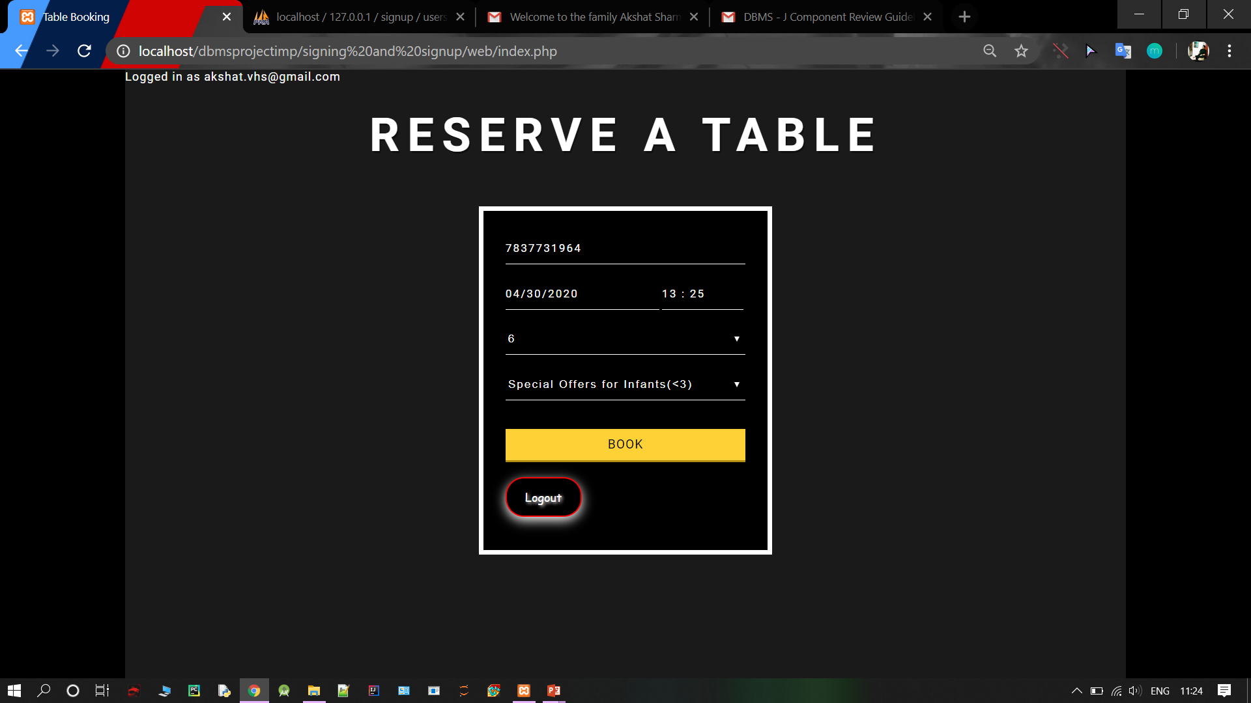
RESERVATION OF TABLE

Slide 14
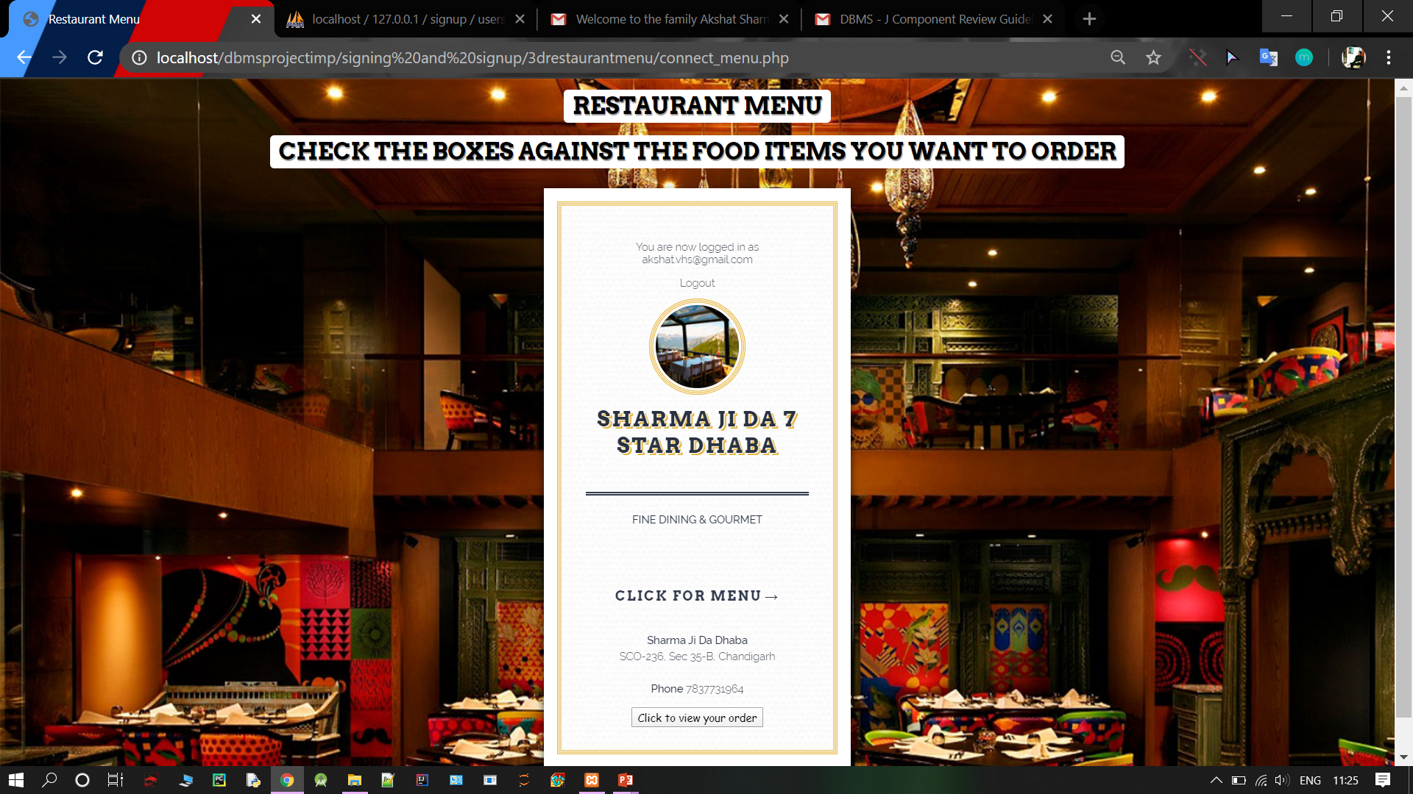
THE OUTLOOK OF THE MENU

Slide 15
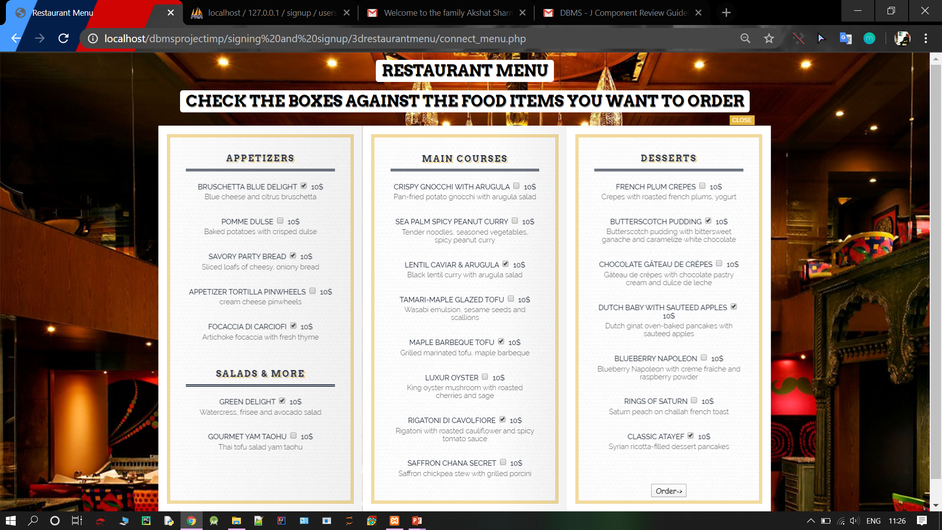
ORDERING FOOD BY CHECKING AGAINST THE ITEMS WANTED

Slide 16
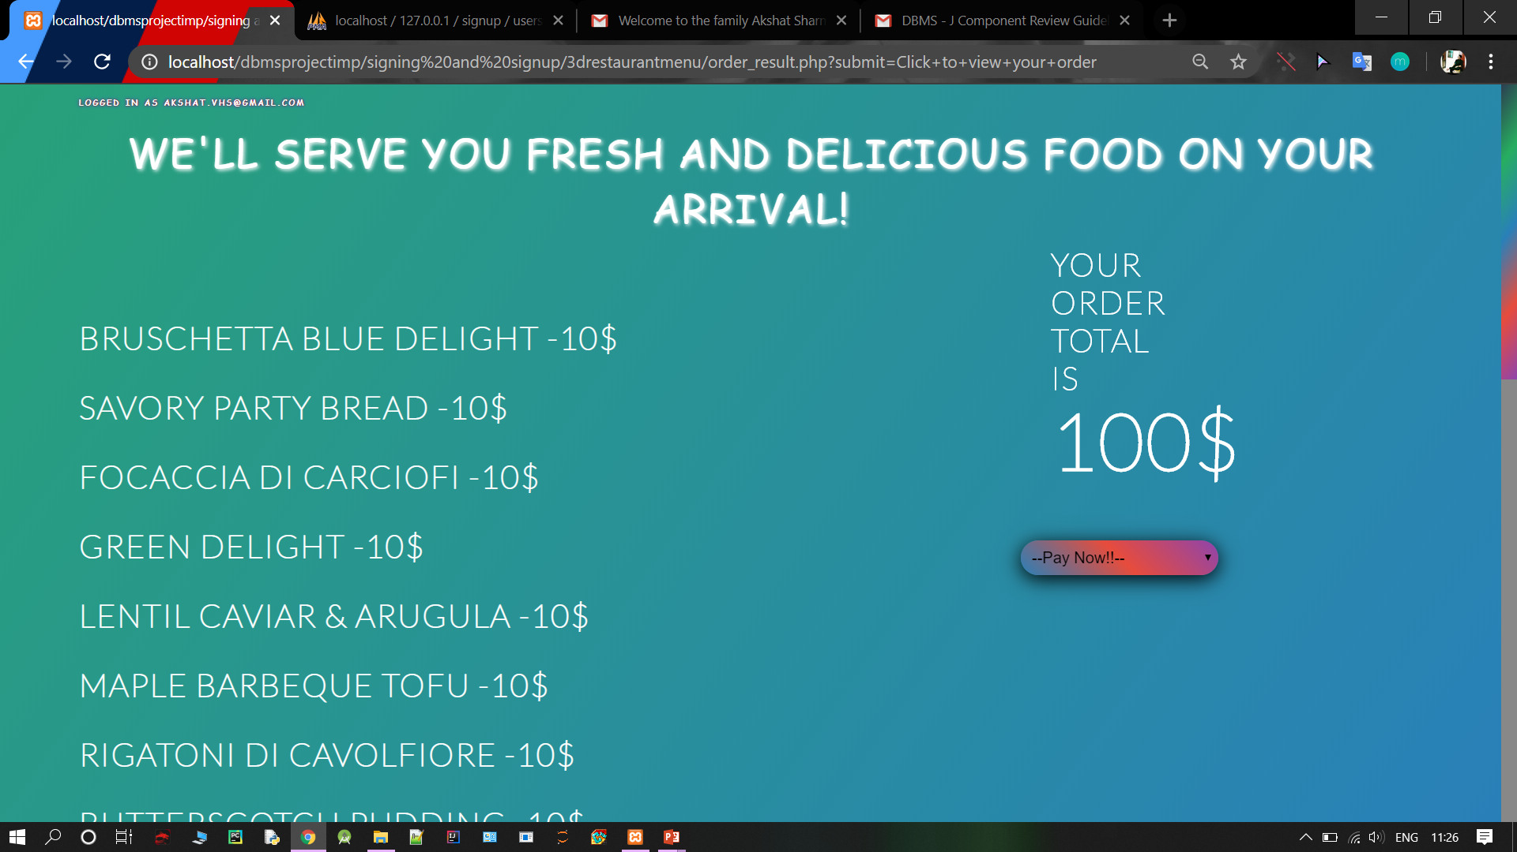
THE WHOLE ORDER IN A SCROLLABLE PAGE

Slide 17
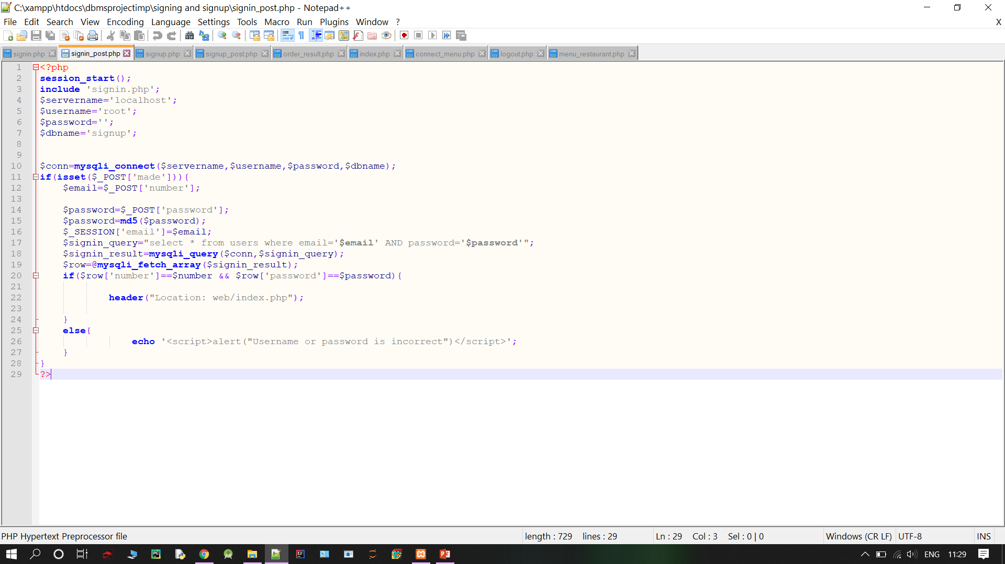
ALL THE FOLDERS OPEN OF MY WEBSITE IN NOTEPAD++ AND ACCESS TO DATABASE CODE

Slide 18
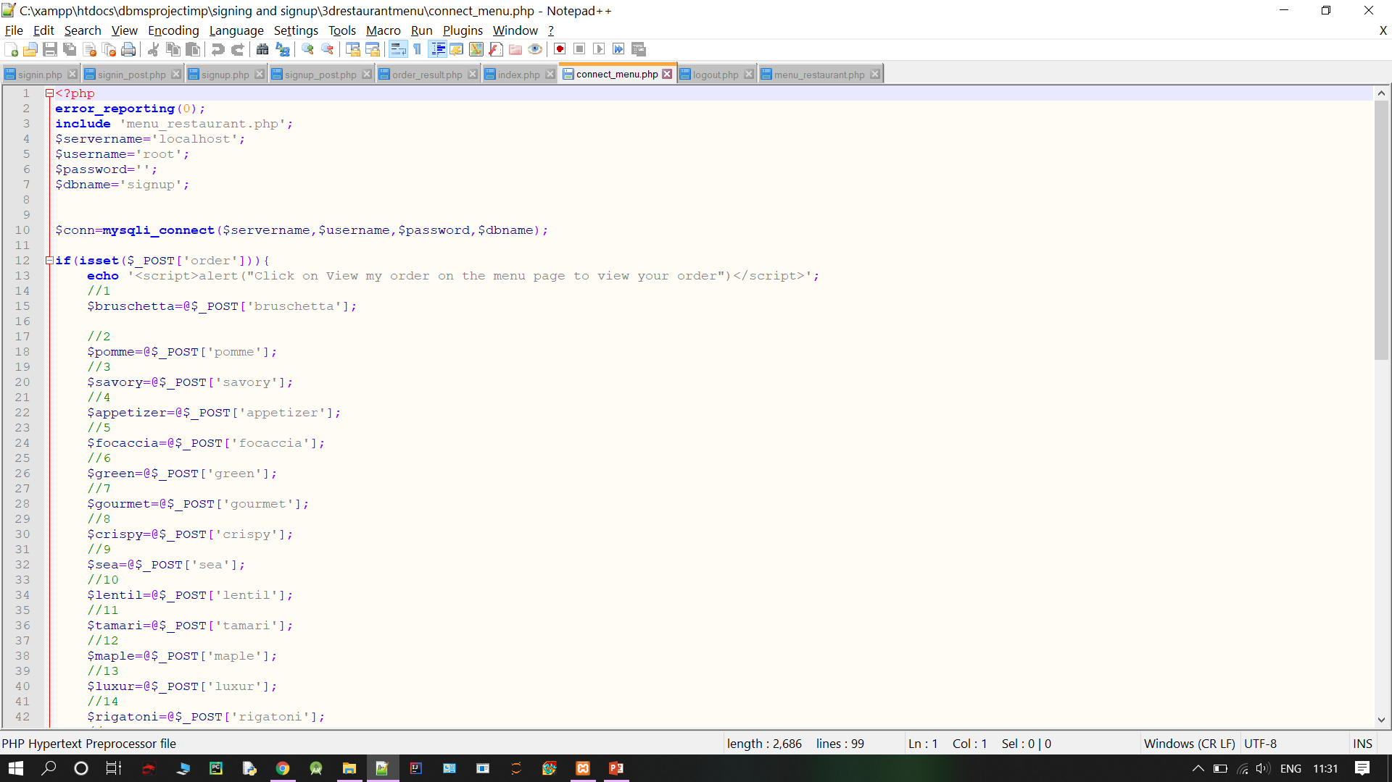
SOME MISCELLANEOUS SCREENSHOTS

Slide 19
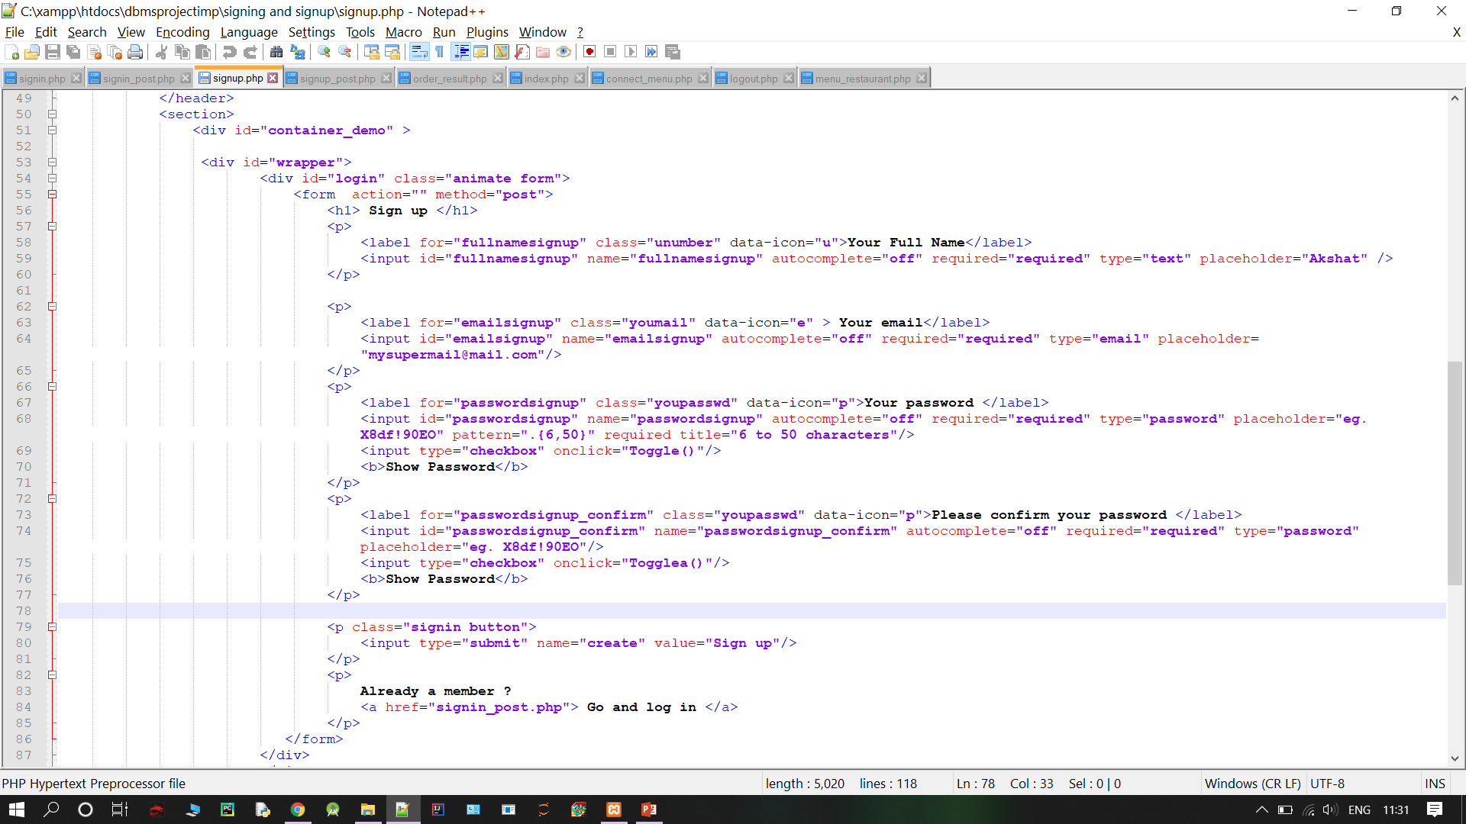
SOME MORE

